Slide 1

Capstone Project The Dungeons of JJAK
Team JJAK

Slide 2
Presentation Outline
Pre-Development
Motivations and existing Influences
Purposes/Goals
Development process
Application content
Demonstration
Deployment
Future Development
Acknowledgements
Framework usage
Team member roles

Slide 3
Early Motivations
User data aggregation to improve systems
Client/Server communication
Authentication
Database communication
Video games
Multiplayer functionality
Client/Server

Slide 4
Game Influences
Table-top roleplaying
D&D, Pathfinder, Call of Cthulhu
Turn-based combat
Pokémon, Knights of Pen & Paper, Darkest Dungeon
Tactical combat
Final Fantasy Tactics, Fire Emblem, XCOM

Slide 5
Purpose/Goals
Create a base game that we could improve upon over time.
Create a synthesis of features we found appealing
Implement currently trending back/frontend features
Authentication, user data tracking, ad revenue

Slide 6
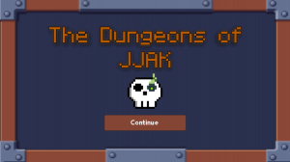
Features and Design Overview
Pixel art graphics
Character creation/selection
Game mode selection
Backend components
User data, authentication
Database communications

Slide 7
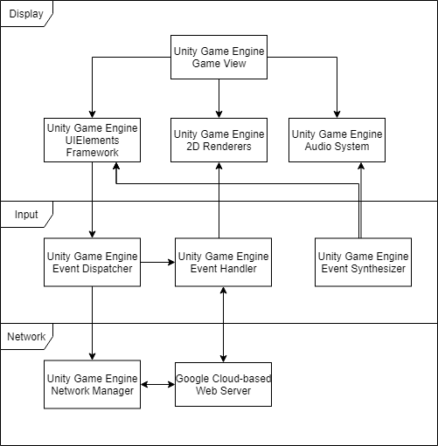
Hypothetical Technical Architecture
Unity’s development environment was fairly inclusive for our purposes
Event synthesizers, handlers, dispatchers
UI element framework
Audio Systems
2D and 3D renderers
Network managers
Google Firebase would provide web services that Unity could not
Database management
Authentication
User data tracking

Slide 8
Development Process
Gantt chart: step-by-step based on component importance
Eventually a divide-and-conquer method was adopted instead
Script work was done in C# with JetBrains Rider’s and Visual Studio with Unity plugins
All art assets were handcrafted with the studio at pixilart.com

Slide 9



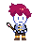
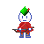
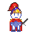
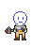
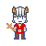
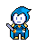
Design: Pixel Art
To avoid legal issues, pixel art featured was mostly handcrafted.
Scene backgrounds were acquired from an asset library.
This includes icons, character sprites, and some text.
Generic sprites for characters were created for potential future classes and color palette swaps.

Slide 10
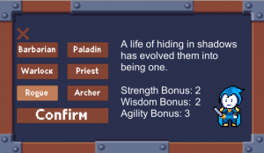
Features: Character Selection
There are currently 6 characters
Room to add more
Short description for each character
Each character has a set of special moves, on top of attack and defend actions
Effects like damage reduction, healing, over time spells, stuns were included, as well as regular attacks
Characters have base stats
Agility, Wisdom, Strength
Stats can be improved upon to fit playstyle
Dropped Features
Color palette skin swaps
Custom Appearances

Slide 11
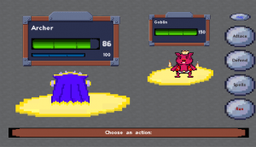
Features: Game Modes
Game modes were split between single player and versus
Players choose their character and stats
Character names could also be chosen to display on the UI during combat
Single players can fight prefabricated boss monsters
Eventually we planned on making this part of a dungeon crawl mode
Versus mode utilizes Photon API for matchmaking
We also wanted to implement a team mode after the dungeon crawl was implemented

Slide 12
Backend Features
User data collection for analysis
Improving the game via statistics about character usage, win percentage, stat build usage
Location data to cater to audiences
Authentication via Firebase API
Inventory implementation
Saved character builds
Leveling system

Slide 13

Video Demonstration

Slide 14

Initial Launch
Our current product is initially launching on the Google Play Store for Android
Apple App Store and IOS are possible with minor additions to firebase communication scripts and costs to upload

Slide 15
Development Problems
Learning curve with Unity and Firebase
Unity Pro application times
Revision of original direction
Removal of parts that were unnecessary at the time

Slide 16
Future Development
Reimplementation of color palette swaps and skins.
Team vs Boss, Dungeon Crawl, Vs. Bots
Bot levels
Inventory system
Ability animations
Additional characters
IOS launch

Slide 17



Frameworks and Development Environments
Unity game engine
Script Implementation
Cross-platform development
UI design and functionality
Photon API
Real-time multiplayer functionality
Full Serializer by Jacob Dufault
JSON serialization for web communications
Google Firebase & Rest Client APIs
User data aggregation
Database management
HTTP requests
Pixilart.com

Slide 18
JJAK Team Members
Jonathan Perez
Gameplay/Server Communication Engineer
Jordan McFarlane
Creative Lead/Website Designer
Andrew Durkin
Project Manager/Server Communication Engineer
Kyle Arnold
Gameplay Engineer
Dr. Brian Adams
Capstone Project Advisor

Slide 19
Other References
CraftPix (Background Art): https://craftpix.net/
Zenva Academy (Multiplayer): http://academy.zenva.com/
uNicoDev (Firebase & Rest): https://www.youtube.com/channel/UCiKZ0GfG4AMCDhdm4J99fjQ
Brackeys (Unity): https://www.youtube.com/user/Brackeys

